Slide 1
Emmet county Planning Commission
May 5, 2022

Slide 2
PSPR21-09 Grand management & development
Site plan review
No new information received – applicant did not respond to requests for new information
Bear Creek Township – voted to recommend Denial

Slide 3
PSUP22-005 Special use permit – bob carson
Accessory building exception
5645 E Bear River Road
Bear Creek Township

Slide 4
Location map

Slide 5
Aerial map

Slide 6
Plot plan

Slide 7
Elevation plans

Slide 8
facts
The property is zoned FF-2 Farm and Forest.
The property is approximately 69.67 acres.
The property is currently vacant.
The proposed building meets the setback standards of the Zoning District (Front = 400’ (from R-O-W); Side = 600’+; 200’ +; Rear 2000').
Accessory building permitted size = 2,400 sq. ft. (rear yard); accessory building size proposed = 3,840 sq. ft.
Building is proposed to be 16 feet tall.
Location partially screened from Bear River Road with trees.
Road Commission driveway permit has been issued.
Applicant plans a future residence on the property.

Slide 9
Site photo

Slide 10
Plot plan

Slide 11
Psup22-006 – special use permit – joseph wilson
Accessory building as a main use
4553 Straits View Drive
Wawatam Township

Slide 12
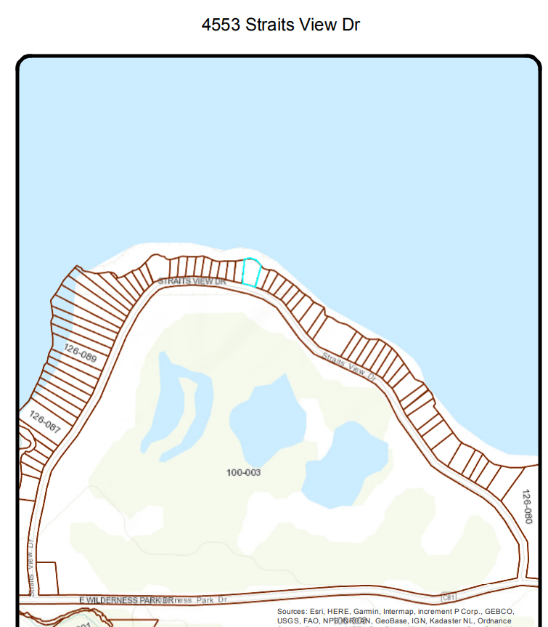
Location map

Slide 13
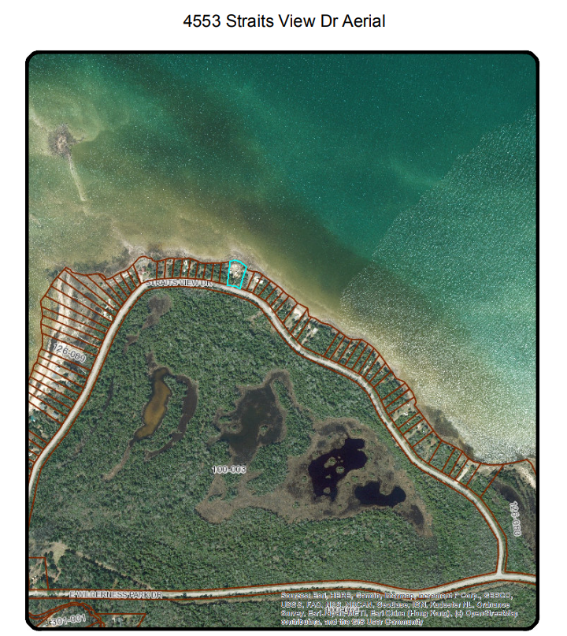
Aerial map

Slide 14
Plot plan

Slide 15
Elevation/rendering

Slide 16
facts
The property is zoned RR-Recreation Residential.
The property is approximately 0.51 acres in area.
The property is comprised of two platted lots in the Plat of Mackinaw Shores.
Proposal is to construct an accessory building without a main use. The applicant proposes to bring a 488 square foot pre-built structure onto the property for seasonal day use. No house has been constructed on the property.
Per Section 22.01.1 B an accessory building without a main use can be permitted on a residentially zoned property if reviewed and approved by the Planning Commission.
The applicant does not propose to connect the building to a well or septic system.
Currently, a Recreational Vehicle, port-a-john, and minor accessory building (under 200 sq. ft.) exist on the property.
The property can be accessed by an existing driveway.
Wawatam Township recommended approval.

Slide 17
Site photos

Slide 18
Site photos

Slide 19
Site photos

Slide 20
Plot plan

Slide 21
Pspr22-003 Site plan review- jartar real estate dev. llc
Proposed car wash in a B-2 zoning district
1285 N US 31 HWY
Bear Creek Township

Slide 22
Location map

Slide 23
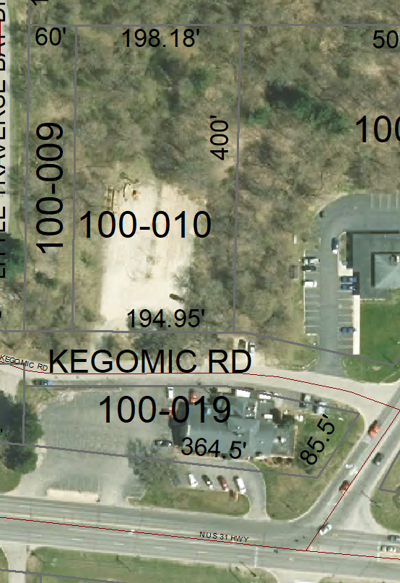
Aerial map

Slide 24
Overall site plan for 1285 US 31 N & 2745 Kegomic Rd

Slide 25
Existing site plan

Slide 26
Existing conditions

Slide 27
Proposed site plan 4/19/2022

Slide 28
elevations

Slide 29
Vacuum plans

Slide 30
Landscape plan

Slide 31
facts
The property is zoned B-2 General Commercial.
The property is 0.76 acres.
Zoning to the south, north, east and west is the same zoning district, B-2 General Commercial. Adjacent uses include: north: State Police Detachment center, south: lumber/contractor supply retail business, east: vacant lot, west: insurance office.
Access would be N US 31 HWY and Kegomic Road. ECRC is satisfied with the locations and plans for access onto Kegomic Road. MDOT is satisfied with the access onto US 31 Highway and appreciate the access management closing 2 existing entries.
The proposal is to allow a new carwash.
The Zoning Board of Appeals approved setback variances to the parking on the north and south sides of the parcel (9’ variances) and building setback variance of 1’ – as shown on the site plan dated April 19, 2022. The proposal reduces the non-conforming status of the buildings as to location.
Proposed building is 155’ x 29’.
Three employee parking spaces are provided.
A carwash is a permitted use in the B-2 General Commercial zoning district.

Slide 32
Facts continued
The applicant proposes to eliminate two entrances onto N US 31 HWY.
A sealed drainage plan provided. Reduced impervious surface is proposed. Estimated cost for drainage system is $40,000.
On site well proposed for the site. The site is proposed to be served by sanitary sewer.
Snow management shown on the plan.
Landscape plan has been provided.
Emmet County Road Commission and MDOT have both provided comments – approving the proposed access locations. Proposed accesses onto Kegomic Road and US 31 Hwy are acceptable to the road agencies.
Elevation plan provided, height standard met.
Fire Chief review provided.
No outdoor lighting identified. Signage and Lighting can be reviewed administratively at a future time.
Township recommended approval with conditions.

Slide 33
rendering

Slide 34
rendering

Slide 35
rendering

Slide 36
rendering

Slide 37
rendering

Slide 38
Site photos

Slide 39
Proposed site plan dated 4/19/2022

Slide 40
Site photos

Slide 41
Site photos

Slide 42
Proposed site plan dated 4/19/2022

Slide 43
Pspr22-003 – site plan review – jartar real estate dev. llc
Car Detail Center
Kegomic Road (north side – address TBD)
Bear Creek Township

Slide 44
Location map

Slide 45
Aerial map

Slide 46
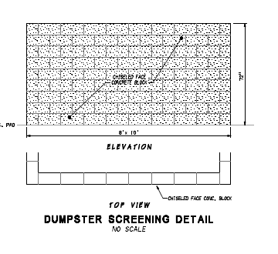
Proposed site plan 4/13/2022

Slide 47
4/19/2022 Updated Site Plan – showing vacuum stations

Slide 48
Vacuum graphics

Slide 49
Elevation plans

Slide 50
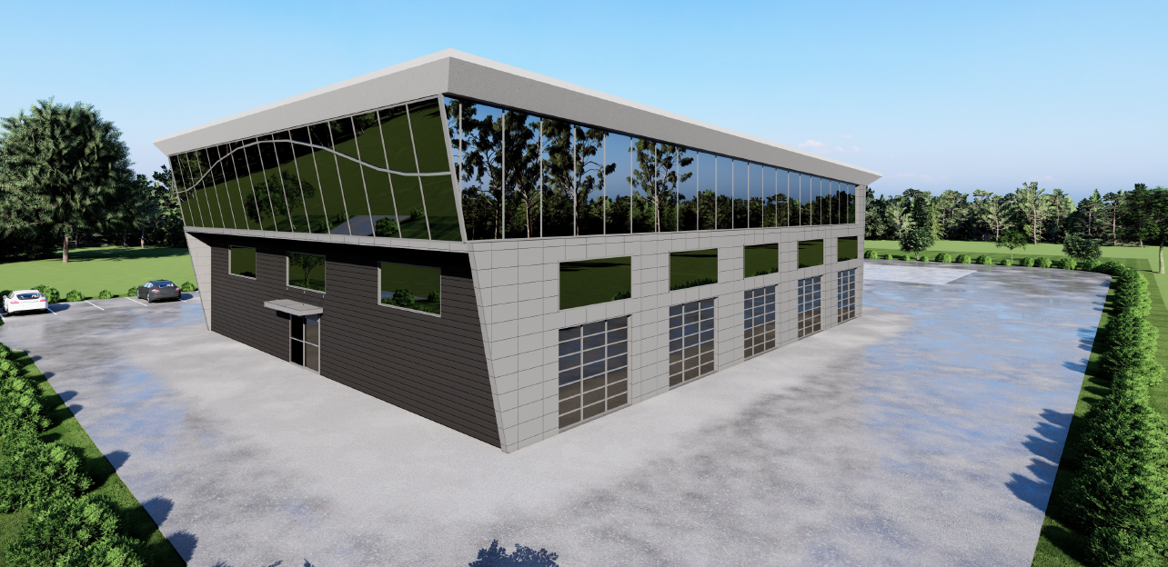
rendering

Slide 51
rendering

Slide 52
rendering

Slide 53
rendering

Slide 54
rendering

Slide 55
facts
The property is zoned B-2 General Commercial.
The property is 1.65 acres.
Zoning to the south, north, east and west is the same zoning district, B-2 General Commercial. Adjacent uses include: insurance office – southwest, state police post – east, vacant land directly north and west, proposed carwash – south.
Access would be via Kegomic Road. ECRC review pending.
The proposal is to allow a new auto detailing facility and parking area for RV detailing.
The proposed building meets the required setback standards of the B-2 District.
Proposed building is 80’ x 100’, plus a 12’ x 20’ bump out.
Twenty parking spaces are provided. One ADA parking space is provided, the entrance to the building is not provided, staff cannot determine if there is a clear pathway to the building.
An auto detailing facility is similar to a carwash and is a permitted use in the B-2 General Commercial zoning district.

Slide 56
Facts continued
A sealed drainage plan provided. Estimate for drainage = $42,000.
An on-site well is proposed for the site. The site is proposed to be served by sanitary sewer.
Dumpster details provided and updated site plan shows concrete enclosure.
No elevation plans provided.
Snow management shown on the plan.
Plan is missing landscaping plan.
No off-street loading area identified.
No outdoor lighting identified. Signage and Lighting can be reviewed administratively at a future time.
Township recommended approval.

Slide 57
photos

Slide 58
4/19/2022 Updated Site Plan – showing vacuum stations

Slide 59
Pptext22-01 – zoning amendment proposed to adus

Slide 60
Pptext22-01 – zoning amendment proposed to adus
Bear Creek and Friendship Townships recommended approval.
Springvale and Readmond Townships recommended denial.
Littlefield Township recommendation pending.

Slide 61
Other business
Administratively Reviewed Site Plan – American Spoon Foods – 1588 River Rd
Zoning Ordinance/Master Plan review – currently being reviewed by outside legal counsel – need 3 volunteers to review proposed changes before bringing to the full commission

Slide 62
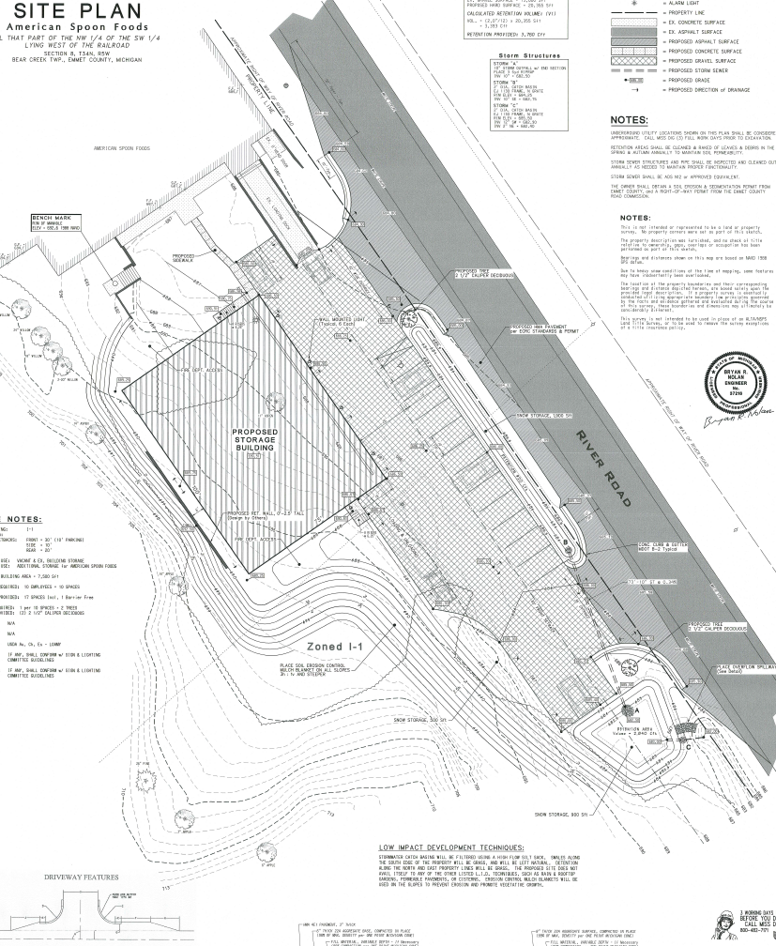
1588 River Rd

